Slide 1
Biomedical Imaging X-Ray Imaging (I)
Sebastian Kozerke
Institute for Biomedical Engineering, University and ETH Zurich, Switzerland

Slide 2
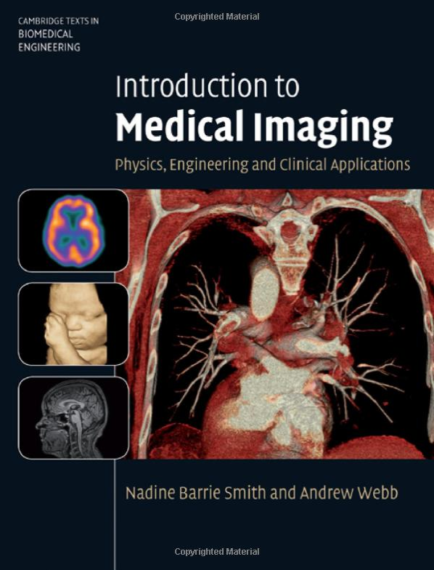
Lecture notes
Handouts + Exercises
https://moodle-app2.let.ethz.ch/course/view.php?id=11546
Book
Introduction to Medical Imaging
Cambridge University Press
Nadine Barrie Smith, Andrew Webb
www.library.ethz.ch ➔ online access

Slide 3


Exercises
Matlab based (in groups of two); problem solving
Tue
Wed
Thu
Fri
Sat
Sun
Mon
Tue
Exercise #X
13-15 HG E7 Lecture
13-15 HG E19 Computer room
15-16 HG E7 Exercise (preparation)
15-16 HG E7 Exercise (solution, discussion)
Mon <23:59 Submit Solution in Moodle

Slide 4
Today’s Learning Objectives
Describe mechanisms of X-ray generation and X-ray spectrum
Relate interaction of X-rays in tissue to tissue properties
Illustrate basic instrumentation for planar radiography
Derive relation between modular transfer and spatial resolution
Implement basic X-ray projection setup (Exercise)

Slide 5
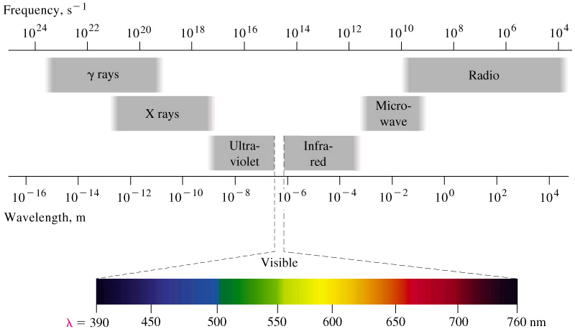
Medical imaging
Electromagnetic spectrum and attenuation in the body
Gamma
Radio
X-ray
Micro
UV
IR
10⁻¹⁶
10⁻¹⁴
10⁻¹²
10⁻¹⁰
10⁻⁸
10⁻⁶
10⁻⁴
10⁻²
10⁰
10²
10⁴
wave length [m]
Notes:
Wavelength
Gamma: 100 pm
X-ray: 10 pm-10 nm
Light: 390-760 nm
Micro: 0.1-30 cm
Radio: 10 cm – 10 km

Slide 6
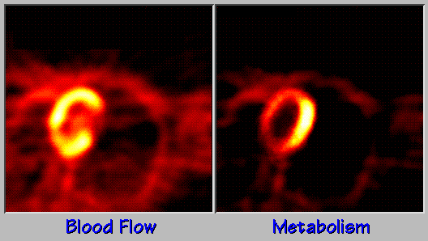
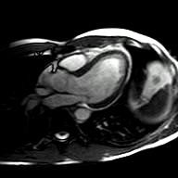

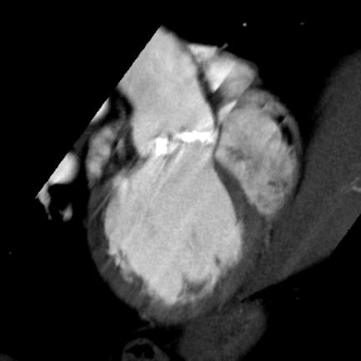
Medical imaging
Gamma
Radio
X-ray
Micro
UV
IR
10⁻¹⁶
10⁻¹⁴
10⁻¹²
10⁻¹⁰
10⁻⁸
10⁻⁶
10⁻⁴
10⁻²
10⁰
10²
10⁴
wave length [m]
PET
MRI
X-ray, CT

Slide 7
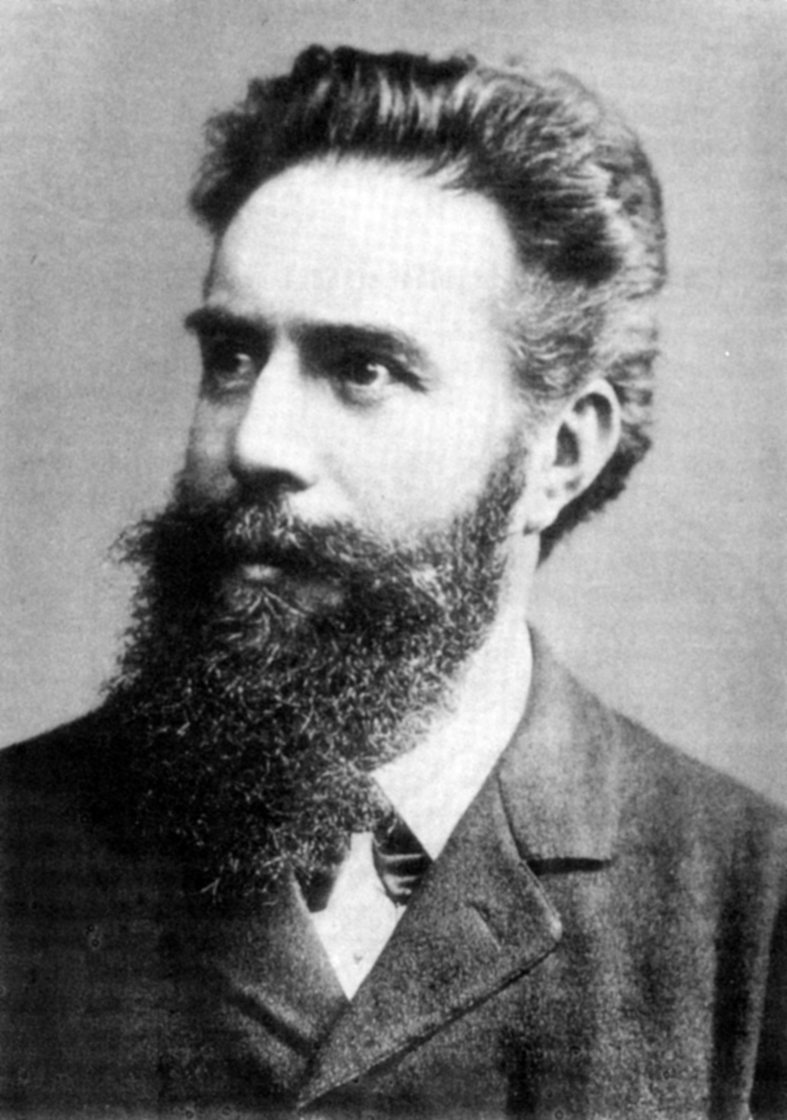
Wilhelm Conrad Röntgen, 1845-1923
7

Slide 8
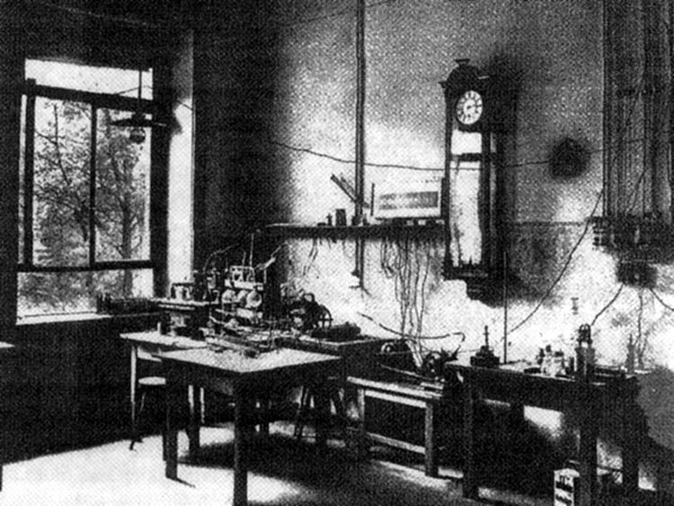
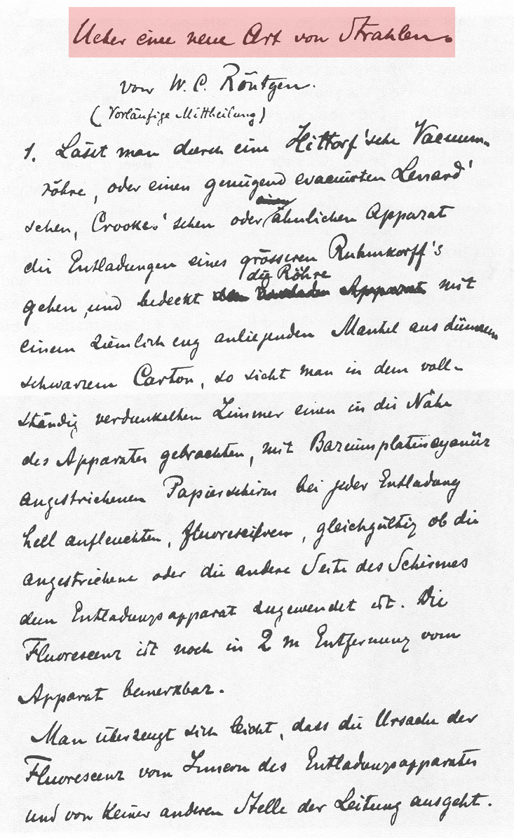
Wilhelm Conrad Röntgen, 1845-1923
8
Notes:
Notes
When the German physicist Wilhelm Conrad Röntgen did experiments on Cathode ray's with a Crookes tube, he discovered while working, that a plate of barium platinocyanide (fluorescent crystals) on a nearby table in his workroom glowed when he activated the tube. Even when he covered the tube with black material it kept glowing. Roentgen named this new phenomena X-Rays.
Wilhelm Conrad Röntgen (in English: "William Conrad Roentgen") (March 27, 1845 – February 10, 1923) was a German physicist, of the University of Würzburg, who, on November 8, 1895, produced and detected electromagnetic radiation in a wavelength range today known as x-rays or Röntgen Rays, an achievement that earned him the first Nobel Prize in Physics in 1901.
Röntgen was born in Lennep (now a part of Remscheid), Germany, to a clothmaker. His family moved to Apeldoorn in the Netherlands when he was three years old. He received his early education at the Institute of Martinus Herman van Doorn. He later attended Utrecht Technical School, from which he was expelled for producing a caricature of one of the teachers, a "crime" he claimed not to have committed.
In 1865, he tried to attend the University of Utrecht without having the necessary credentials required for a regular student. Hearing that he could enter the Federal Polytechnic Institute in Zurich, today the ETH Zurich, by passing its examinations, he began studies there as a student of mechanical engineering. In 1869, he graduated with a Ph.D. from the University of Zurich.
In the next experiments he used photographic material and made his first X-Ray picture, the hand of his wife Anna Bertha!

Slide 9
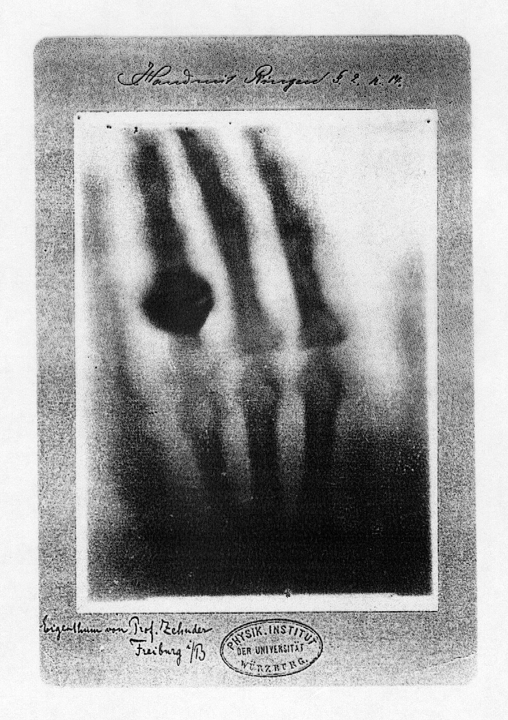

X-ray image (1895)
Original x-ray image made by W.C. Röntgen (hand of his wife)
9

Slide 10
X-rays in medical imaging
Radiography
Thorax, bones etc.
Computed Tomography (CT)
Bones and soft tissue
Angiography
Angiography
Using contrast agent
Digital subtraction angiography (DSA)
Fluoroscopy
Guidance of interventional procedures

Slide 11
Chapter 2.2-2.3
Generation of X-rays

Slide 12
Generation
fast electrons
X-ray photons
target with heavy atoms
Electrons interact with inner e⁻ shells of target (X-rays are not radioactive!)
Notes:
Blackboard
-> radiation consists of quanta
-> radiation energy is integer multiple of single quantum energy
-> single quantum energy depends on frequency -> Planck: E = h ⋅ ν = e ⋅ U (h = 6.62⋅10⁻³⁴ Js; 1 Js = 1 W/s²)
-> because of energy quantization radiation can be considered a particle stream (particle = photon)
-> E = m ⋅ c² -> impulse of photon: p = m ⋅ c = h ⋅ ν / c (photons always travel at speed of light)
Notes
The electronvolt (eV) is the amount of kinetic energy gained by a single unbound electron when it passes
through an electrostatic potential difference of one volt, in vacuum. In other words, it is equal to one volt
(1 volt = 1 joule per coulomb) times the charge of a single electron (in coulombs). 1 eV = 1.6⋅10⁻¹⁹ J

Slide 13
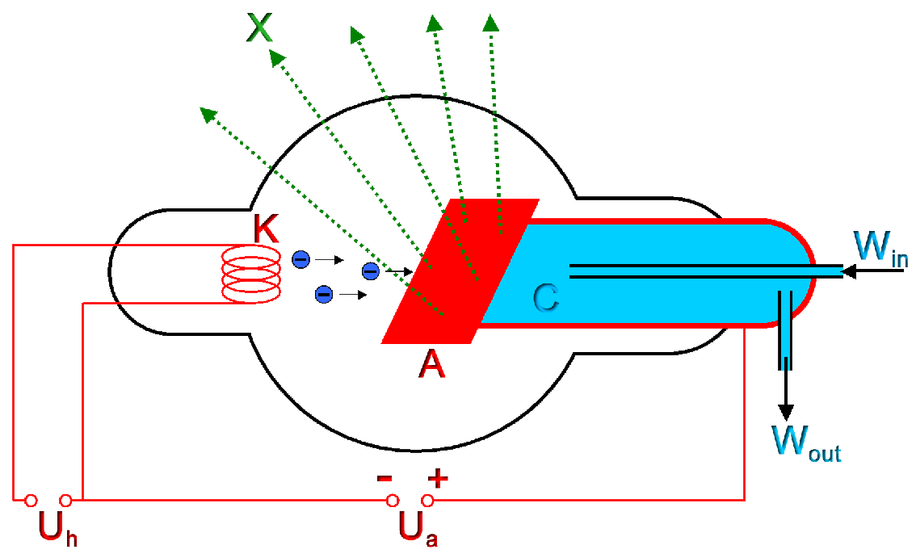
Generation – X-ray tube
Acceleration of electron in vacuum tube (U_{A} = 30-200 kV, I_{A} = 50-100 mA)
13
Notes:
Blackboard
-> wanted: λ_{min} = h ⋅ c / e ⋅ U (U = 100 kV)
-> λ_{min} = 6.6⋅10⁻³⁴ Js ⋅ 3⋅10⁸ m/s / 1.6⋅10⁻¹⁹ C / 1⋅10⁵ V = 1.25 ⋅ 10⁻¹¹ m = 12.5 pm (remember: 1V = 1J/C)
Notes
-> 1 ångström (Å) = 10^{–10} metres = 0.1 nm = 100 pm
-> λ of typical diagnostic X-rays: 10 pm-10 nm

Slide 14
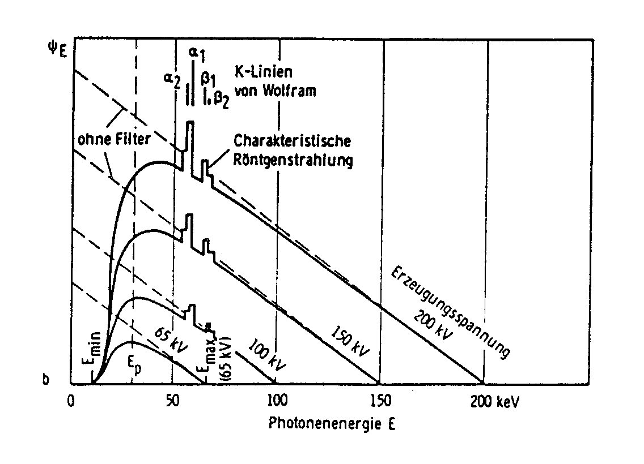
Generation – Spectrum
Wolfram target (1 mm Al prefilter)
K-lines of
wolfram
without filter
characteristic
x-ray
photon flux
anode voltage
photon energy
Bremsstrahlung ➔ continuous spectrum
Characteristic radiation ➔ peaks/lines

Slide 15
Generation – Bremsstrahlung
c
X-ray photon
fast
electron
slower
nucleus
Fast-moving electron decelerates when it swings around a heavy nucleus:
electron interacts with electrons in outer shells
energy depends on distance at which electron passes nuclei
spectrum continuous 0 -> E_{max}
interaction depends on Z value and E of electrons
Notes:
Notes
Bremsstrahlung (help·info), (from the German bremsen, to brake and Strahlung, radiation, thus, "braking radiation" or "deceleration radiation"), is electromagnetic radiation produced by the acceleration of a charged particle, such as an electron, when deflected by another charged particle, such as an atomic nucleus. The term is also used to refer to the process of producing the radiation. Bremsstrahlung has a continuous spectrum. The phenomenon was discovered by Nikola Tesla during high frequency research he conducted between 1888 and 1897.

Slide 16
Generation – Bremsstrahlung
Wolfram target (1 mm Al prefilter)
K-lines of
wolfram
without filter
characteristic
x-ray
photon flux
anode voltage
photon energy
Bremsstrahlung ➔ continuous spectrum
Characteristic radiation ➔ peaks/lines

Slide 17
Generation – Characteristic radiation
1)
2)
3)
photo electron
“hole”
K
L
+
K
L
K
L
+
+
electron
Fast-moving electron interacts tightly with bound electrons in target:
K-shell electron is ejected
Electron energy E_{electron} > E_{binding, K}
Discrete energy of emitted radiation E = E_{binding,K} – E_{binding,L}
Notes:
Blackboard
-> emitted photon energy: ΔE = E_{N}-E_{K} = h ⋅ ν
-> exercise: what is the maximum energy of X-rays from a tungsten target?
-> solution: maximum energy x-rays are generated if a zero-energy electron jumps onto K shell
-> binding energy of electrons E_{binding} = 13.6 eV ⋅ Z²_{eff}
-> Z_{w} = 74 -> E_{max} = h ⋅ ν = 13.6 eV (74-2)² = 70.5 keV (Z_{eff} ~ (Z–2) for nuclei with large Z since electrons with l=0 shield nuclei)
-> λ_{min} = h ⋅ c / E_{max} = 6⋅10⁻³⁴ Js ⋅ 3⋅10⁸ m/s / ( 70.5⋅10³/1.6⋅10-¹⁹ J) = 40 pm

Slide 18
Generation – Characteristic radiation
Wolfram target (1 mm Al prefilter)
K-lines of
wolfram
without filter
characteristic
x-ray
photon flux
anode voltage
photon energy
Bremsstrahlung ➔ continuous spectrum
Characteristic radiation ➔ peaks/lines

Slide 19
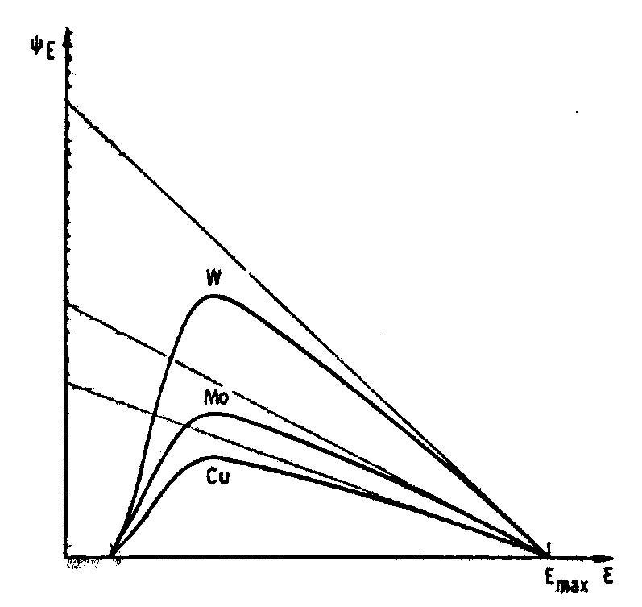
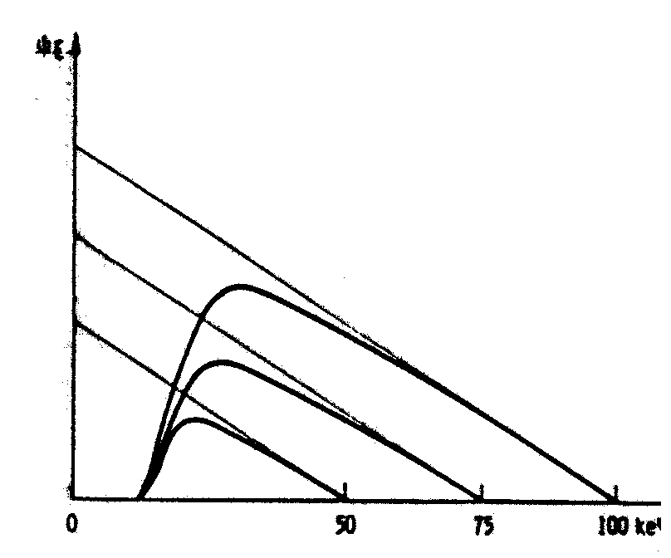
Generation – Materials and Electron energy
photon flux
photon flux
a
a
200 kV
150 kV
100 kV
Energy spectrum (bremsstrahlung, photon
flux as function of energy) in case of various
target materials with pre-filter):
tungsten Z = 74
molybdenum Z = 42
copper Z = 29
Energy spectrum (bremsstrahlung, photon
flux as function of electron energy) for various accelerating fields:
a: Theoretical curve without
prefilter and self-absorption

Slide 20
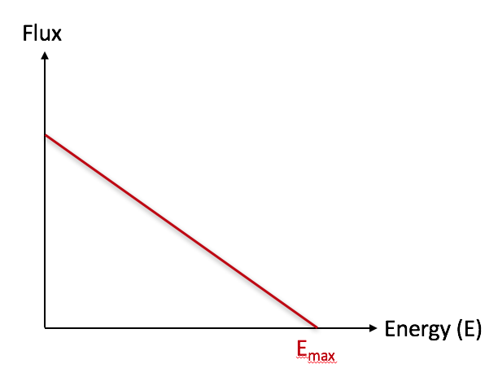


Clicker Activity (5 min)
Imagine the anode material is changed from a thick to a very thin structure (consisting of a single atomic layer) - how would the spectrum shown change?
• Slope of spectrum gets steeper
• E_{max} is shifted to the right
• Spectrum disappears completely
• Constant flux up to E_{max} is seen.
?

Slide 21
Generation – Focal Spot
Anode
Cathode

Slide 22
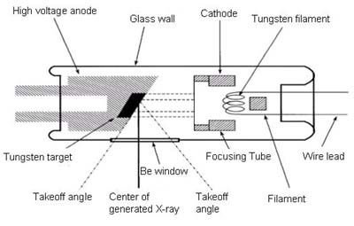
Generation – X-ray tube

Slide 23
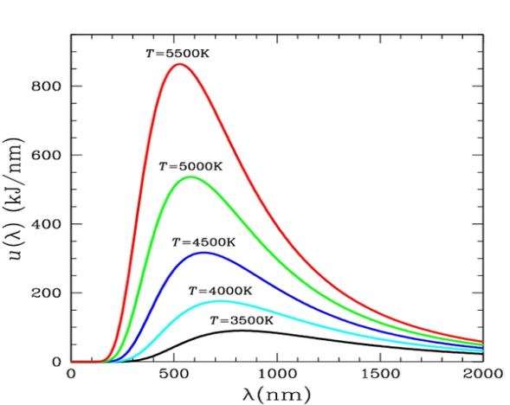
Generation – Heat production
Power absorption:
black body: α = 1
Stefan-Boltzman law:
σ = 5.7 ⋅ 10-12 Wcm-2K-4
Wien’s displacement law:
b = 2.9 ⋅ 10–3 mK
Notes:
Blackboard
-> P = U ⋅ I = 100 kV ⋅ 100 mA = 10 kW
-> 1% X-ray + 99% heat!
-> How much heat is radiated per second and cm² if T_{Anode} = 2000 K given:
- absorption efficiency α = 0.8
-> W = α ⋅ σ ⋅ T⁴ = 73 W⋅cm⁻² = 73 J⋅cm⁻²⋅s⁻¹

Slide 24
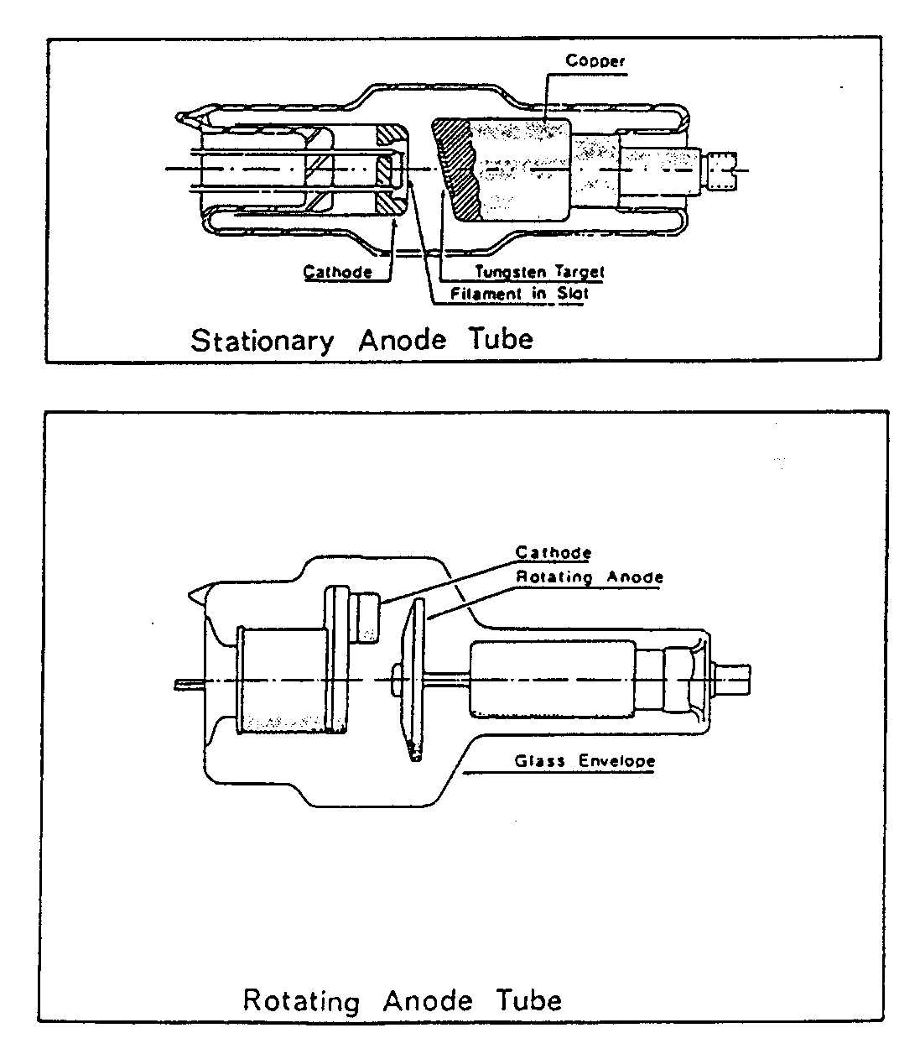
X-ray tube – Stationary and rotating anode

Slide 25
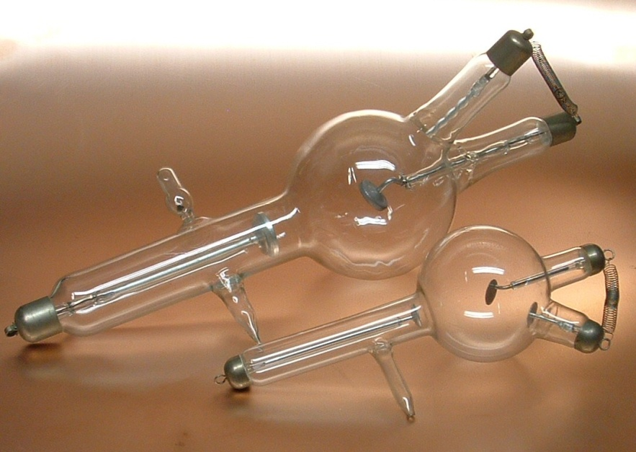
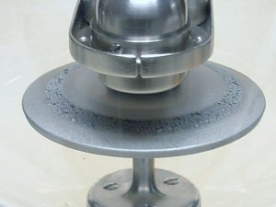
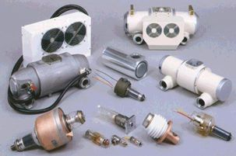
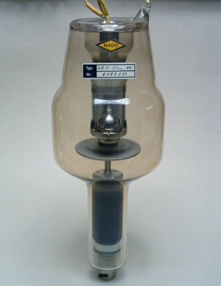
X-ray tube – History
Notes:
In the early times Crookes or Hittorf tubes consists of a view simple electrodes projecting into a glass bulb. With one of these tubes Wilhelm Röntgen made his discovery for which he was awarded for the first Nobel Prize. The classic cold X-Ray tube was born, a tube with two electrodes. The tube developed into a three electrode tube with a platinum target due to the high melting point of this metal. When in 1913 William Coolidge and Lilienfeld made there first hot Cathode X-Ray tube, they replaced the cold Cathode with a heated spiral filament Cathode and tungsten Anode. The angle of the Anode in his tube was set at 45º. X-Ray's could now be better controlled and were more reliable. There was only a practical problem, cooling the Anode, (which got extremely hot) was a huge problem due to it's small size. A new design was developed, a heavy copper base to the Anode, sometimes with water cooling, this conducted the heat away and therefore increased the capacity of the tube to withstand a high current. In 1924 Philips developed the Metalix tube, the glass tube was fitted in a metal housing and also incorporated the principle of line focus. The Anode face was changed at an angle of 19º in respect to the Cathode. Finally the rotating Anode tube was developed. It was first sold in 1929 by Philips and called the Rotalix tube. In the rotating Anode tube the target is a tungsten or wolfram disc that spins so that the focal spot of the Cathode ray is changing and the heat is dissipated. Soon after the discovery of Conrad Roentgen the production of these tubes started, not only in the German factories of Gundelach, Müller, Pressler and Siemens. But also by Philips in Holland and Cuthbert Andrews in England. In the US by Victor and general Electric.

Slide 26
Chapter 2.4-2.5
Attenuation of X-rays

Slide 27
Terminology
Transmission
Photons passing through the body
Absorption
Partial or total absorption of photon energy
Scatter
Photons diverted in a new direction
Attenuation
Absorption + scatter

Slide 28
Attenuation
Attenuation in body with transmission of 80%:
100%
80%
64%
51%
Object
Object
Object
Photo effect
Compton effect
Interaction with bound electrons

Slide 29
Attenuation – Photo effect
1)
2)
3)
photo electron
“hole”
K
L
+
K
L
K
L
+
+
incident photon
Photo effect leads to total absorption of photon:
Generation of characteristic x-ray radiation with low energy
Photo electrons cause biological “damage” ➔ “ionizing radiation”
Probability ~ ρ ⋅ Z³/E³
Notes:
Blackboard
-> energy of incident photon E_{Incidence} = E_{Ejection} + ½ ⋅ m_{e} ⋅ ν²

Slide 30
Attenuation – Compton effect
Back-scatter
Side scatter
Forward scatter
scattered photon
incident photon
recoil electron
Compton effect leads to photon “bouncing”:
Photon loses (part of) its energy to kinetic energy of electron
Detection of photon changes
Recoil electron responsible for “biological” damage
Probability ~ ρ/E
Notes:
Blackboard
-> Compare with billiard hit -> sketch photon hitting an electron a) before hit b) after hit (after hit impulse of photon is p’, of electron P’_{e})
-> conservation of energy: p ⋅ c + mc² = p’ ⋅ c + E’_{e} -> ( p – p’ + mc)² = ( E’_{e}/c )²
-> conservation of momentum: p – p’ = p’_{e}
-> square both sides: p² – 2p⋅p’+p’² = p’_{e}² (p ⋅ p’ = p ⋅ p’ ⋅ cosϕ )
-> further calc
-> λ’-λ = h/(mc) ⋅ (1-cos ϕ) (Compton effect)
-> Scatter problem!

Slide 31
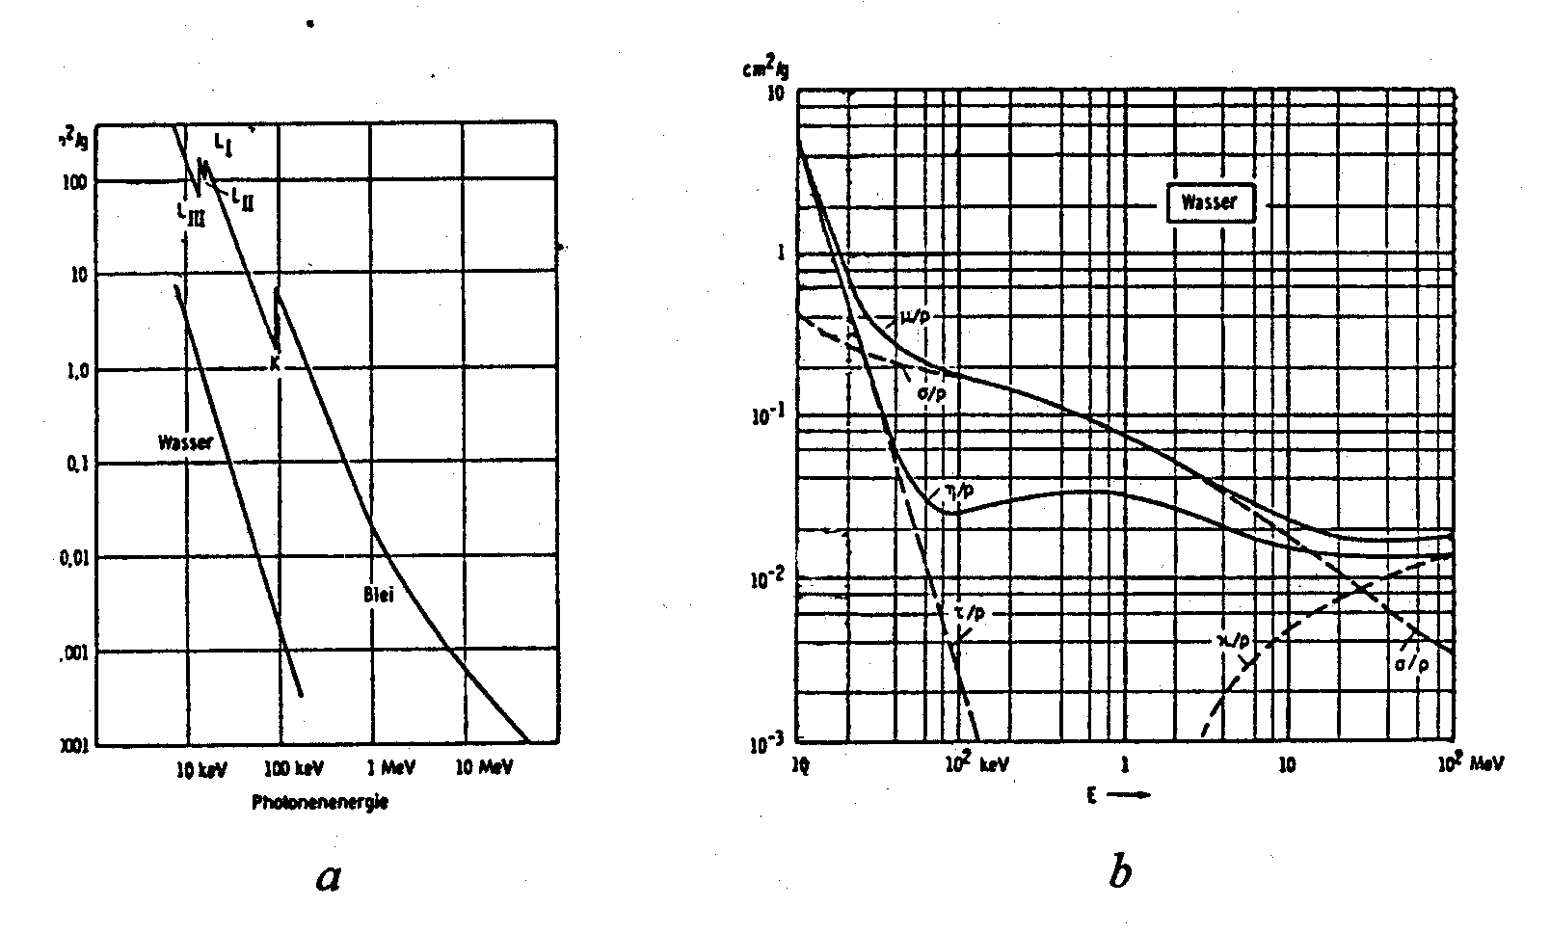
Attenuation – Mass absorption coefficient (μ’)
cm²/g
cm²/g
10
1
0.1
0.01
100
10
1
0.1
0.01
0.001
water
water
lead
10 keV 100 keV 1 MeV 10 MeV
10 keV 100 keV 1 MeV 10 MeV 100 MeV
photon energy
photon energy
a Photoeffect
b Photoeffect (τ/ρ), Comptoneffect (σ/ρ), pair production (κ/ρ)

Slide 32
Attenuation coefficient
Mass attenuation coefficient μ’ [cm²/g]
x-ray
cross section σ
atom
Linear attenuation coefficient μ = μ’ ⋅ ρ [cm⁻¹]
dx
μ
I(x)
I(x+dx)
Notes:
Blackboard
-> mass absorption coefficient μ’ = σ ⋅ N_{A} / A (N_{A}: Avogadro’s number = 6 ⋅ 10²³ / mol, A: atomic weight)
-> sketch: shooting target

Slide 33
Attenuation coefficient
Linear attenuation coefficient μ
dx
μ
I(x)
I(x+dx)
Beer-Lambert’s law
Notes:
Blackboard
-> Beer-Lambert: I(x+dx)-I(x) = -μIdx
-> dI/I = -μdx -> ln|I| = -μx + c -> I = I₀ exp(-μx)

Slide 34
Attenuation – Linear attenuation coefficients (μ’⋅ρ)
μ
μ [cm⁻¹]
bone
muscle
fat
E [keV]

Slide 35
Attenuation – Summary
Photo effect τ
X-ray photon disappears
Photo electron recoils
Effective in contrast agent, lead, bone
Compton effect σ
Interaction with free electrons
Scatter
Water, air, soft tissue, bone
(Pair production κ )
Electron-positron pair requires E > 1 MeV
Not relevant in medical imaging

Slide 36
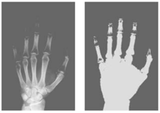
Clicker Activity (5 min)
Assign energy values to the two projection images and explain the reasons for the differences in image contrast and signal intensity
• left/right: same energy but different display window/level settings
• left: high energy, right: low energy
• left: low energy, right: high energy
?

Slide 37
Projection imaging

Slide 38
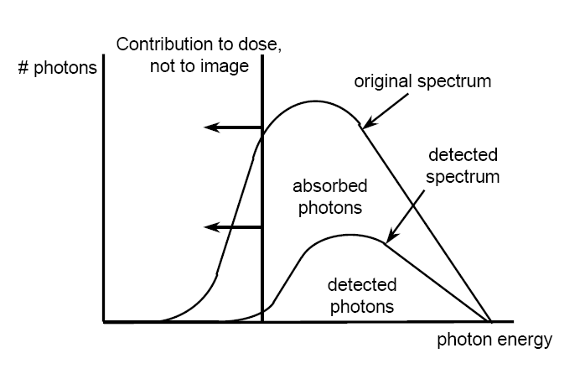
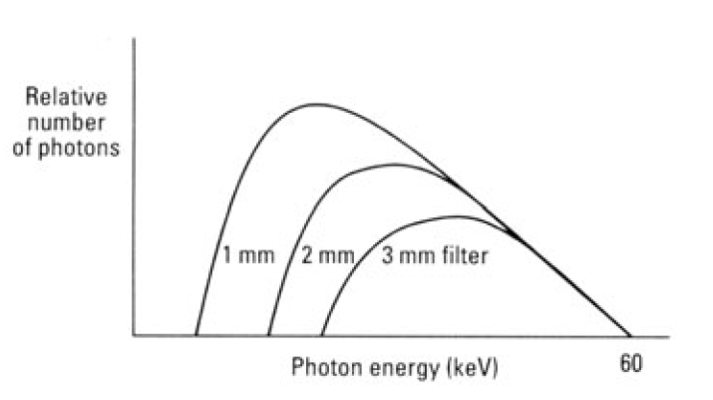
Projection imaging – Pre-filtering
x-rays
Detector
Aluminum filter
Aluminum filter thickness
Notes:
Notes
-> Low energy photons do not reach the detector
- absorbed in x-ray tube material and patient (Dose)
- No contribution to the image
-> Inherent filtering in tube (glass, oil, target)
-> Additional filtering to reduce patient dose (aluminum sheets between

Slide 39
Resolution of imaging procedures
Chapter 1.3
Spatial resolution
Blurring of object points when projected into image
Contrast
Difference in linear attenuation coefficients between tissues
Temporal resolution
Sample rate of temporal recording

Slide 40
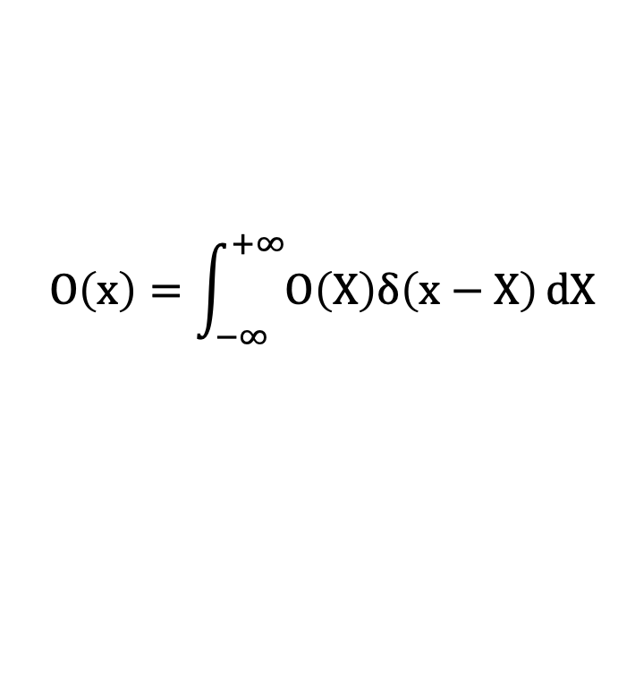
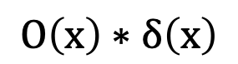
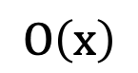
Resolution – Spatial resolution
Object representation
$$O\left(x\right)=\int_{−∞}^{+∞}{O\left(X\right)δ\left(x−X\right)}dX$$
$$O\left(x\right)$$
$$O\left(x\right)∗δ\left(x\right)$$

Slide 41
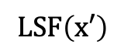
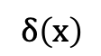
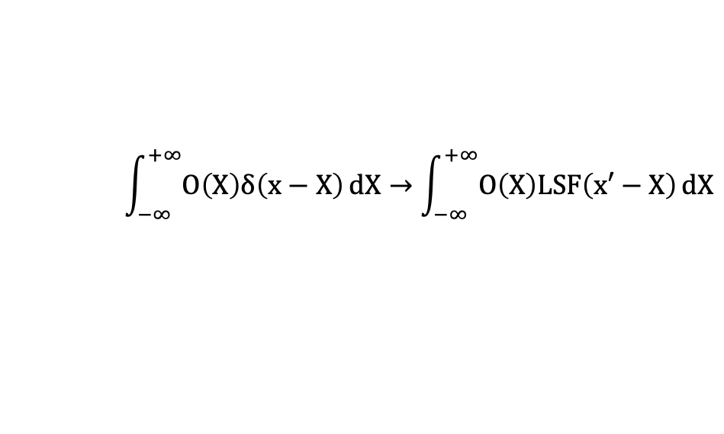
Resolution – Spatial resolution
Mapping object space onto image space
Object space
Image space
$$\int_{−∞}^{+∞}{O\left(X\right)δ\left(x−X\right)}dX→\int_{−∞}^{+∞}{O\left(X\right)LSF\left(x′−X\right)}dX$$
Object space
Image space
$$δ\left(x\right)$$
$$LSF\left(x′\right)$$
“Line Spread Function“ (LSF)
Notes:
Blackboard
-> Calculate LSF for MRI
- LSF(x) = int(exp(jkx)) k_{max}=-k_{min}=π/Δx
- LSF(x) = 2sin(π⋅x/Δx)/x
-> LSF in X-ray is determined experimentally with lead grids

Slide 42
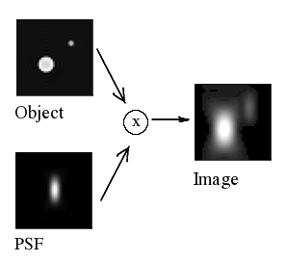
Resolution – Spatial resolution
Mapping object space onto image space (1D → 2D)
1D: LSF → 2D: PSF
PSF: Point Spread Function

Slide 43
Resolution – Spatial resolution
Fourier series representation of object
Wave number (see:. spatial frequency = k-space in MRI):
Mapping Fourier representation of object onto image:
Notes:
Blackboard
-> use x’’ = x’ – X
-> sin(X) = sin(x’-x’’) = sin(x’)cos(x’’) – cos(x’)sin(x’’)

Slide 44
Resolution – Spatial resolution
Mapping Fourier representation of object onto image:
Object space
Image space
“MTF: Modulation Transfer Function”
Notes:
Blackboard
-> use x’’ = x’ – X
-> sin(X) = sin(x’-x’’) = sin(x’)cos(x’’) – cos(x’)sin(x’’)

Slide 45
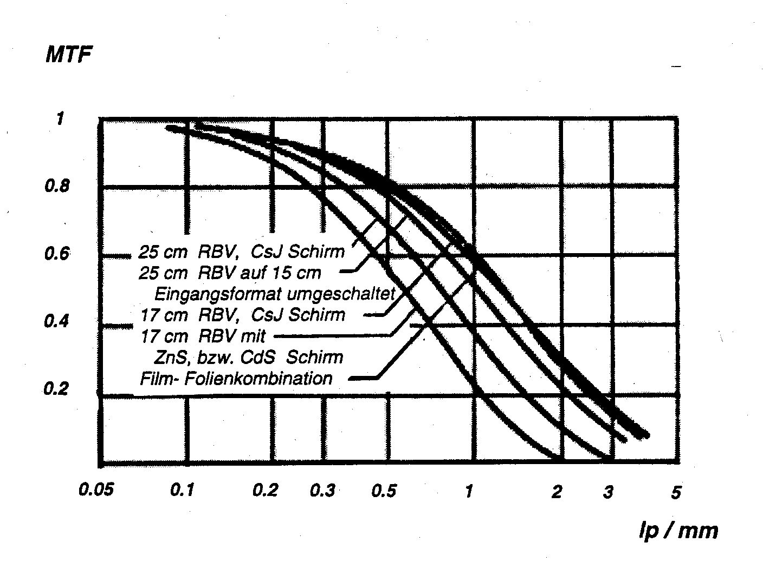
Resolution – Modular Transfer Functions (MTF)
1:
2:
3:
4:
5:
25 cm image intensifyer,
CsJ screen
25 cm image intensifyer,
15 cm setting
17 cm image intensifyer,
CsJ screen
17 cm image intensifyer,
ZnS or CdS screen
Film- intensifying screen
combination
1
2
3
4
5
MTF in
lp/mm
lp/mm: line pairs per mm

Slide 46
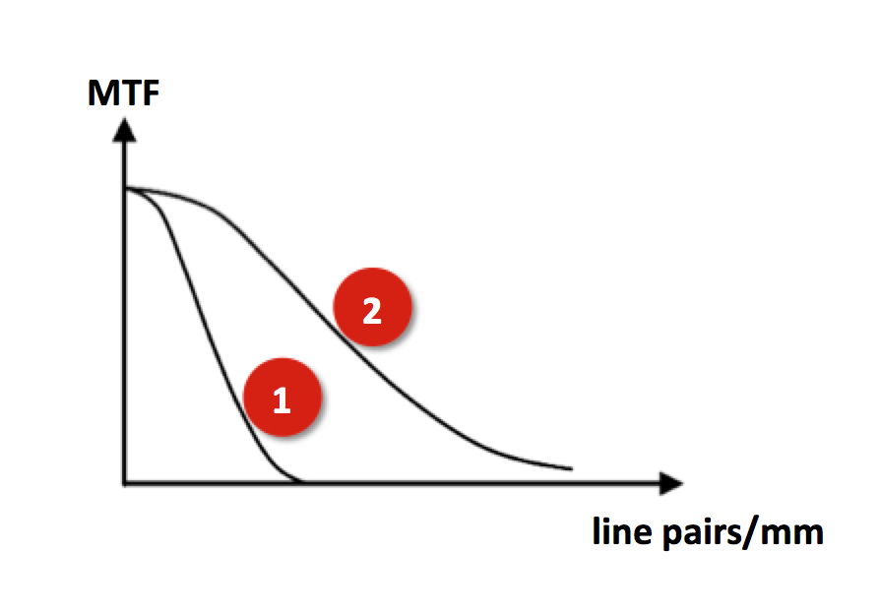
Clicker Activity (5 min)
Compare the Modular Transfer Function (MTF) of two different imaging systems
• The imaging system with MTF #1 yields best resolution
• The imaging system with MTF #2 yields best resolution
• Resolution of #1 and #2 is identical
?

Slide 47
“The most important slides”

